Slide 1
Cloud Infrastructure in Public Sector
-Vinod Kotiya
Senior IT Professional
Presentation Video on : http://youtube.com/vinodkotiya

Slide 2
whoami
Senior Manager IT, Bangladesh-India Friendship Power Company Limited
RGPV Bhopal
NTPC Limited
IMF

Slide 3

Interactive Poll
Q1-2
http://tiny.cc/rgpv
Or
http://etc.ch/tPNP

Slide 4
Conversational Domain for Cloud
XaaS (Anything-as-a-Service),
Private/Public/Hybrid cloud
Elastic (Commgg)
Scaling
Demography
Virtualization
Vendor lock-in
Consumption-based pricing model
Cloud Sourcing
Subscription
Multi-tenancy
Vertical/Horizontal Cloud
Cloud Portability
Cloud Backup
Agile Infra
Cloud Migration
Cloud storming
Cloud Broker/Integrator
SLA
Cloud Providers

Slide 5
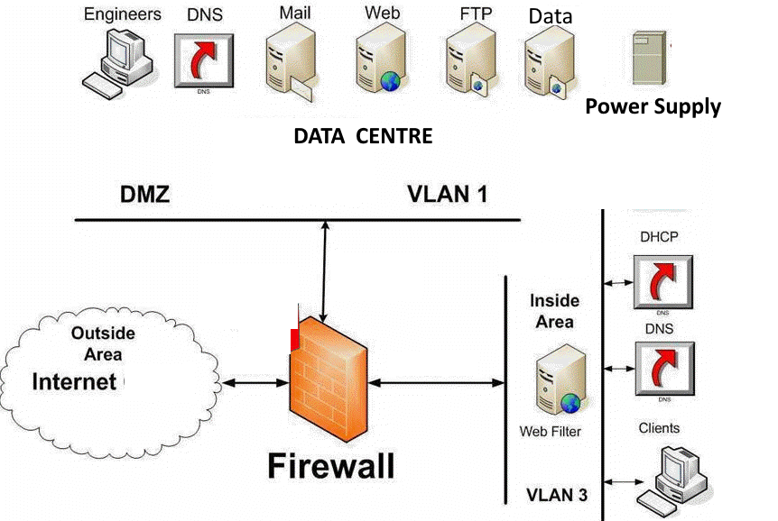
Traditional IT Infrastructure
Q3-4

Slide 6
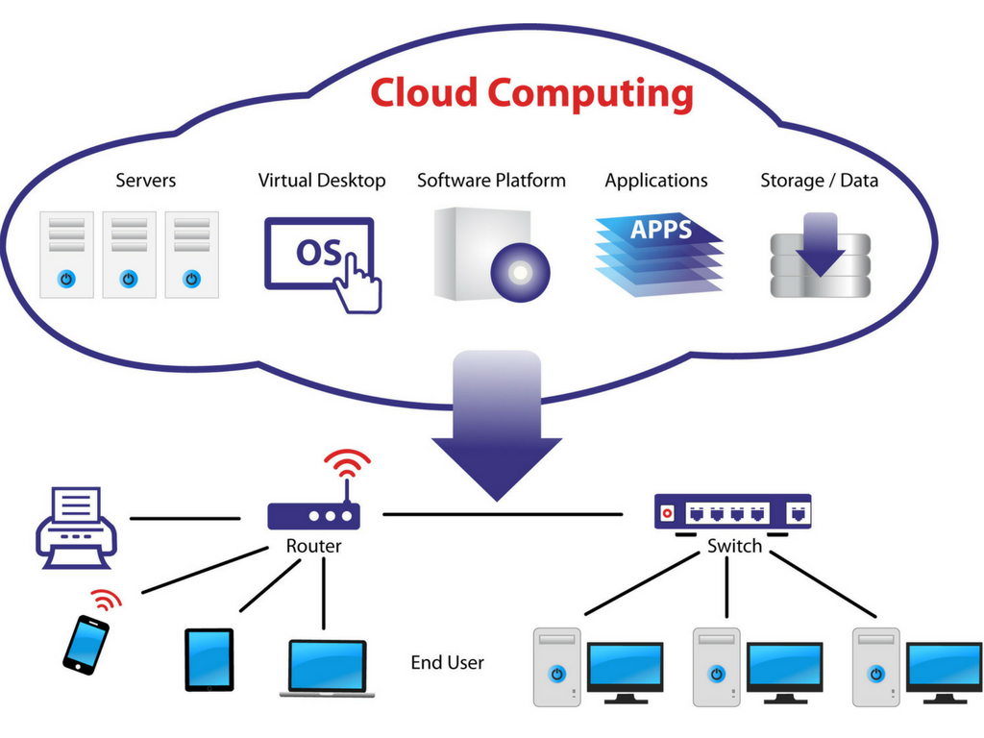
Cloud Infrastructure

Slide 7
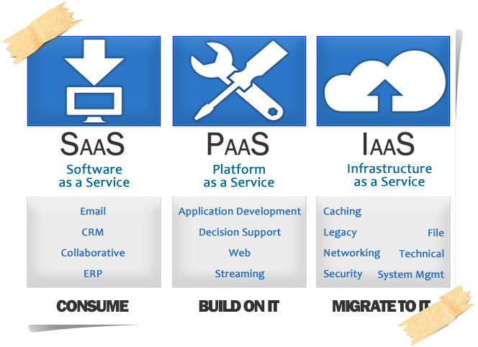
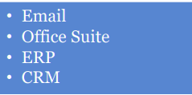
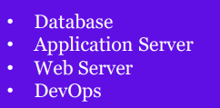
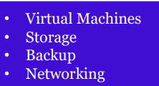
Cloud Service Models
Q5-6
Software is licensed on a subscription basis and is centrally hosted
Platform to develop, run, and manage applications without infra management
Provision processing, storage, networks, and other computing resources

Slide 8
Examples of SaaS, PaaS, and IaaS
SaaS examples: BigCommerce, Google Apps, Salesforce, Dropbox, MailChimp, ZenDesk, DocuSign, Slack, Hubspot, Office365.
PaaS examples: AWS Elastic Beanstalk, Heroku, Windows Azure (mostly used as PaaS), Force.com, OpenShift, Apache Stratos, Magento Commerce Cloud.
IaaS examples: AWS EC2, Rackspace, Google Compute Engine (GCE), Digital Ocean, Magento 1 Enterprise Edition*.

Slide 9
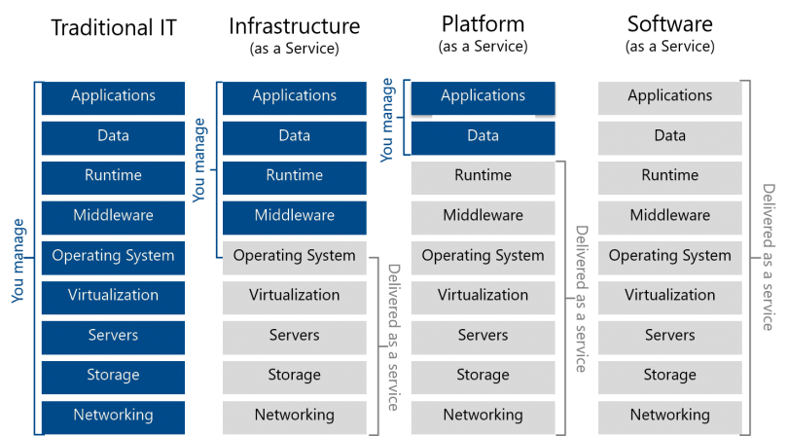
Traditional v/s Cloud

Slide 10
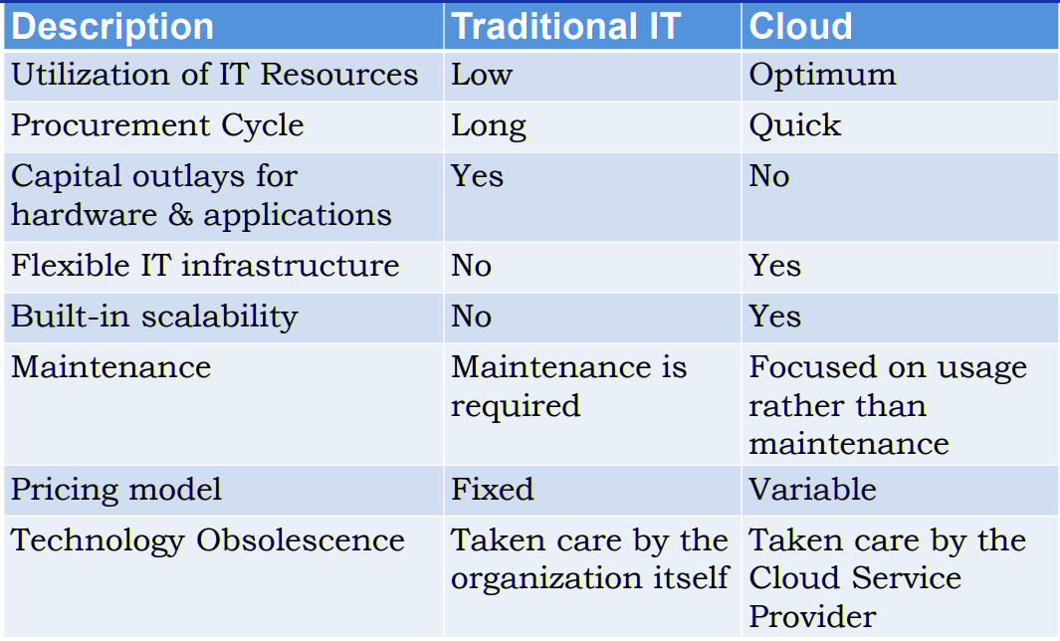
Traditional v/s Cloud

Slide 11
Cloud Characteristic
On Demand Self-Service
Broad Network Access
Rapid Elasticity
Resource Pooling
Measured Service
Virtualization
Geogr. Distribution

Slide 12
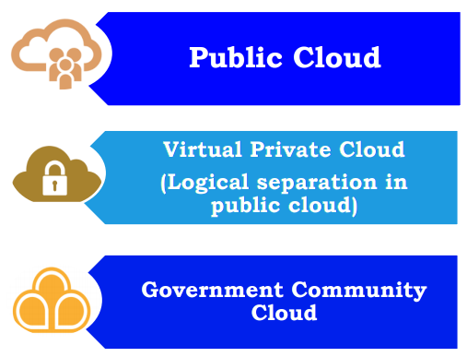
Cloud Deployment Models

Slide 13
Public Cloud
The cloud infrastructure is provisioned for open use by the general public. Chances are you use some sort of public cloud product already. Offerings are:
SaaS – G-Suite, Microsoft 365, Dropbox, etc…
PaaS – Google App Engine, Heroku…
IaaS – Microsoft Azure, Amazon Web Services, Google Cloud Platform
Pros | Cons
Low price (sometimes even free) | Security concerns
Scalable | The law and location of your data
Location independence | Lack of control
It‘s easy! | Lack of customization

Slide 14
Private Cloud
The cloud infrastructure is provisioned exclusive use by a single organization comprising multiple consumers (e.g., business units). On/Off Premises.
Some of the biggest providers are HP, VMware, Dell, Oracle, IBM, Microsoft, and Amazon Web Services
Pros | Cons
Control over cloud setup | Higher setup cost
Control over privacy & security | Less redundancy
Control over the Demography of Data | Less scalability
 | Expert Team requirement

Slide 15
Community Cloud
Q7
The cloud infrastructure is provisioned for exclusive use by a specific community of consumers from organizations that have shared concerns (e.g., mission, security requirements, policy, and compliance. On/Off Premises.
NYSE Capital Market Community Platform. Another example is AWS GovCloud.
Meghraj GI Cloud
Pros | Cons
Control over cloud setup | Compromise – won‘t get the full benefits of either public or private
Control over privacy & security
Cheaper than private cloud
More scalable than private cloud

Slide 16
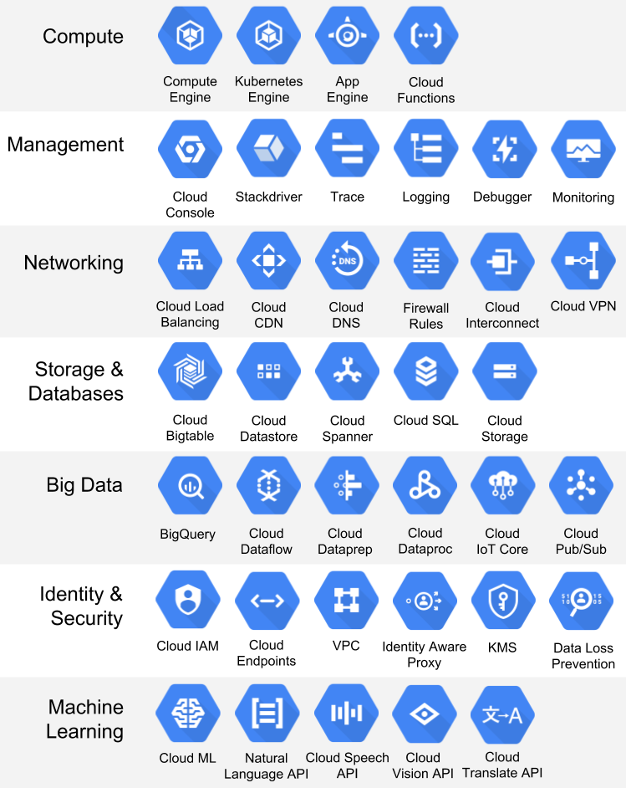
Google Cloud Platform

Slide 17
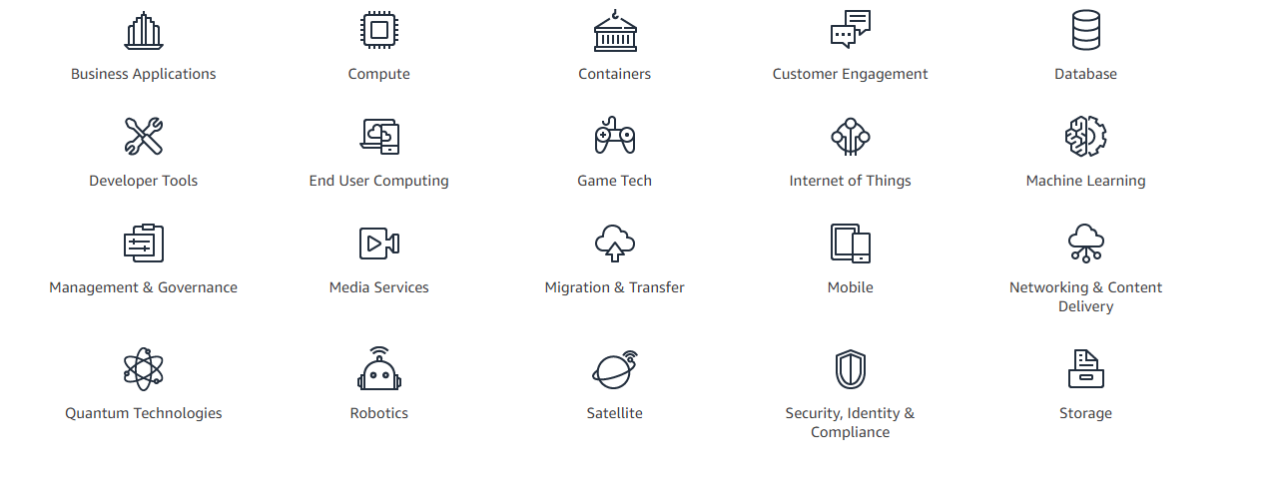
AWS

Slide 18
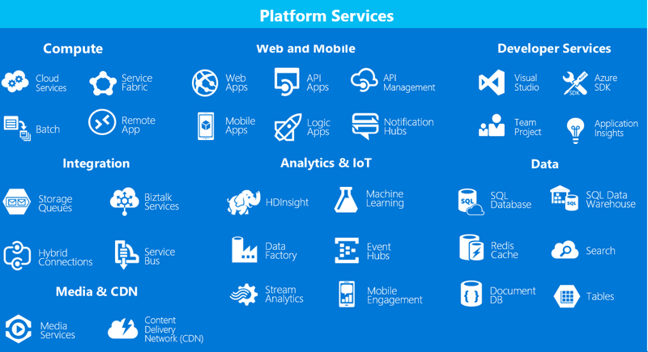
Azure

Slide 19
Cloud for Entrepreneurs
Minimum
Enterprise Email System G-Suite/Office365, Collaboration Tools | $5 pm
Company Website on Cloud and Domain | $ 20-100
Mobile App development on Cloud (App inventor/ Kodular) | Free
HRMS Cloud Solution | $5 pm or Free
Accounting System Cloud Solution | $10 pm
One server compute engine | $50 pm
Marketing Platform CRM(Mail Chimp) | free
Scale-up towards Enterprise

Slide 20
Scenario to adopt cloud for Public Sector
Dev and test environment
Storage
Disaster recovery
Big Data and Analytics
Enterprise application

Slide 21
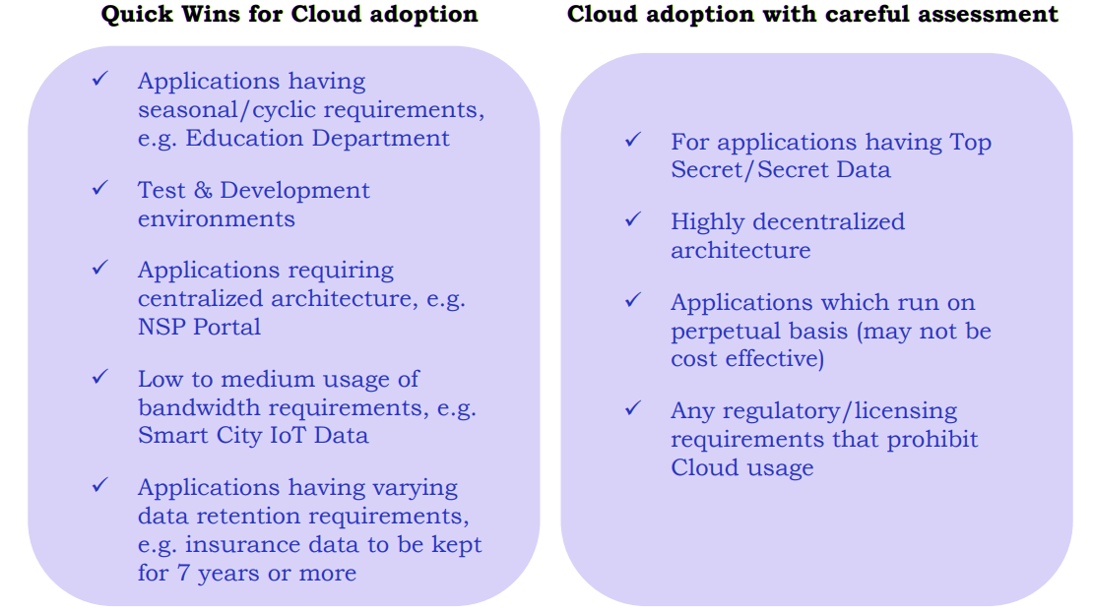
Cloud Adoption Strategy

Slide 22
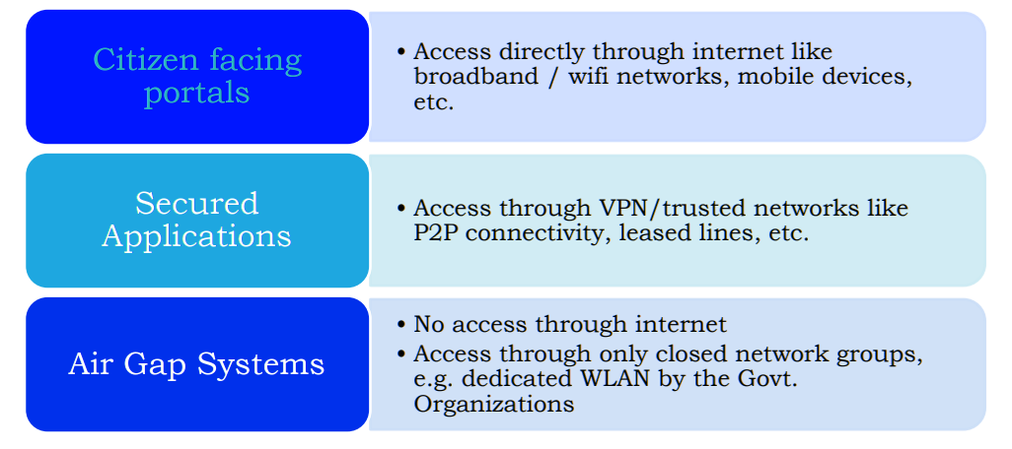
Access based on Criticality

Slide 23
Cloud Migration Approaches for Legacy App
Q8
REHOST on IaaS.
REPLACE with SaaS.
Encapsulate data and functions in the application and make them available as services via an API
Replatform. Migrate an application component to a new runtime platform.
REFACTOR for PaaS. Restructure and optimize existing
code without changing its external behavior
Rearchitect. Materially alter the application code so you can shift it to a new application architecture
REBUILD on PaaS. Rebuild or rewrite the application

Slide 24
Use Cases in Public Sector
Biggest IoT Smart Metering project of Energy Efficiency Services Ltd
NRC Assam
Bhubaneswar Smart City goes live on Cloud
Maharastra State Electricity and Transmission Ltd migrating the huge landscape of SAP applications, mailing solutions, web applications was done securely in just two days
Andhra Pradesh State Skills Development Corporation and Center for Science and Environment using AWS
Pune Municipal Corporation hosts 150 Application on GCC
Tamilnadu Public Distribution System Handles 35k devices concurrently
EESL, MSETCL, RITES, NHAI and others have opted for building and hosting their SAP/HANA ERP systems, which are again mission-critical
STAND UP India
MUDRA Bank
PFC
AAI
Indian Railway using Cloud
Bhopal Smart City Control Center – Covid

Slide 25
Basic Cloud Service for Public Sector
To be listed on the Government eMarketplace (GeM) platform once they have been successfully empaneled by the MeitY
Compute Services
Processor, Storage type, Operating System, Network, Security Software, Backup
Storage Services
Block Storage(HDD), Object Storage(Photo,Video), File Storage(File system)
Database Services
Microsoft SQL, MySQL, Oracle etc.
Network Services
Content Delivery Network (CDN), Virtual Network, Load Balancer, VPN, Firewall
Security Services
Active Directory Services, DDoS, SSL Cert, Multi Factor Authentication

Slide 26
Govt empaneled Cloud Service Providers
Amazon Internet Services Pvt. Ltd. | Net Magic IT Services Private Limited
Bharat Sanchar Nigam Limited (BSNL) | Nxtra Data Ltd.
CtrlS Data Centers Limited | Tata Communications Limited
Cyfuture India Private Limited | Web Werks India Private Limited
ESDS Software Solutions Private Limited | Hewlett Packard Enterprise India
IBM India Private Limited | Sify Technologies Limited
Microsoft Corporation (India)

Slide 27
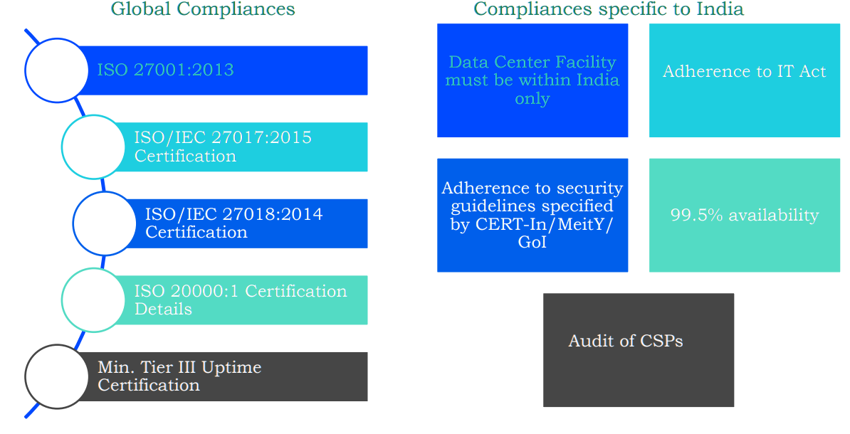
Security Requirement of CSP

Slide 28
Shared Responsibility
Q9
Govt. Department | Cloud Service Provider(CSP)
Identity and access management - Specifying the roles of users for managing access to application, data and platform | Security of infrastructure components (compute, storage, network, etc.) including upgrade, maintenance and patch deployment
Ensuring the security of endpoints that are used to access Cloud services | Virtualization hardening
Configuring operating system, network, firewall & security settings associated with the Cloud service being consumed | Physical and Logical network segmentation
Applying data and server side encryption | Perimeter security services
Reviewing and validating security configurations created by CSP | Providing tools for backup, migration and replication
Reviewing the security incident and monitoring reports submitted by CSPs | Offering Disaster Recovery Services

Slide 29
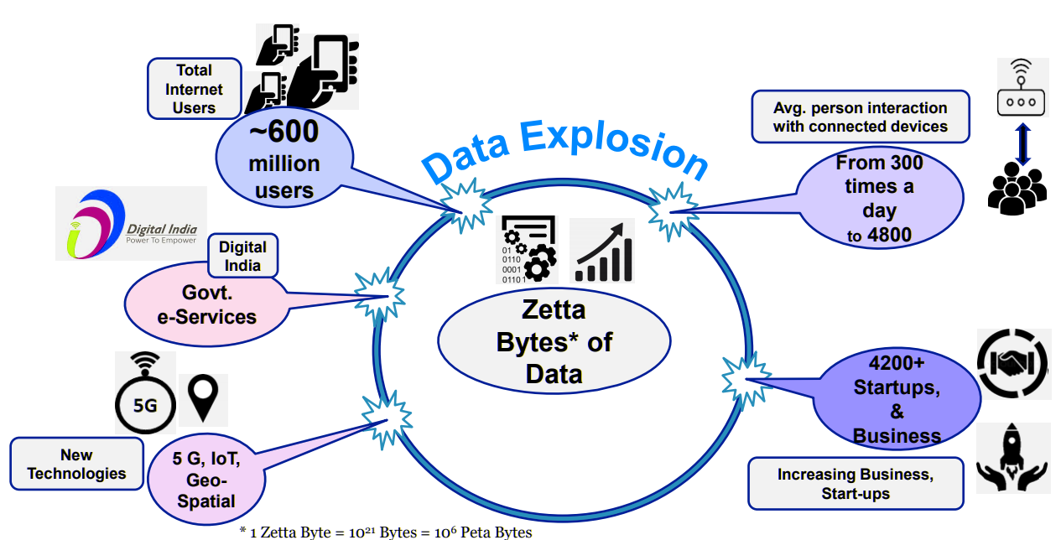
Cloud Opportunity in Public Sector

Slide 30
NIC National Cloud - MeghRaj
National Informatics Centre (NIC) was established in 1976, and has rich experience in providing ICT and eGovernance in social and public administration and facilitates electronic delivery of services to the government (G2G), business (G2B), citizen (G2C) and employee (G2E). NIC, through its ICT Network, “NICNET”, has institutional linkages with all the Ministries /Dept of the Central Gov,State Gov/ UT, and about 720+ District Administrations
Government of India has embarked upon an ambitious initiative - "GI Cloud" which has been named as "MeghRaj". The focus of this initiative is to accelerate delivery of e-services in the country while optimizing ICT spending of the Government. This will ensure optimum utilization of the infrastructure and speed up the development and deployment of eGov applications.
cloud.gov.in

Slide 31
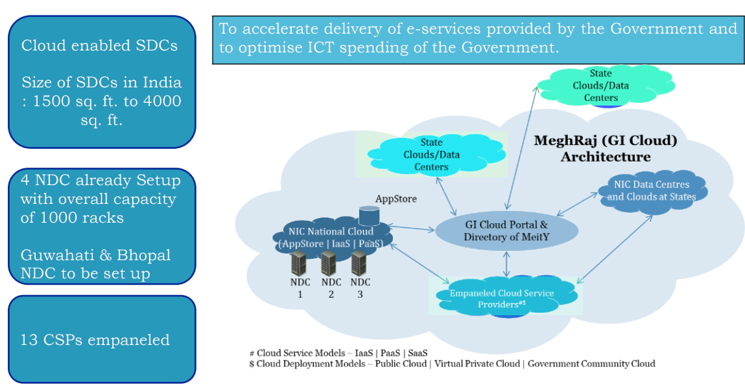
MeghRaj

Slide 32
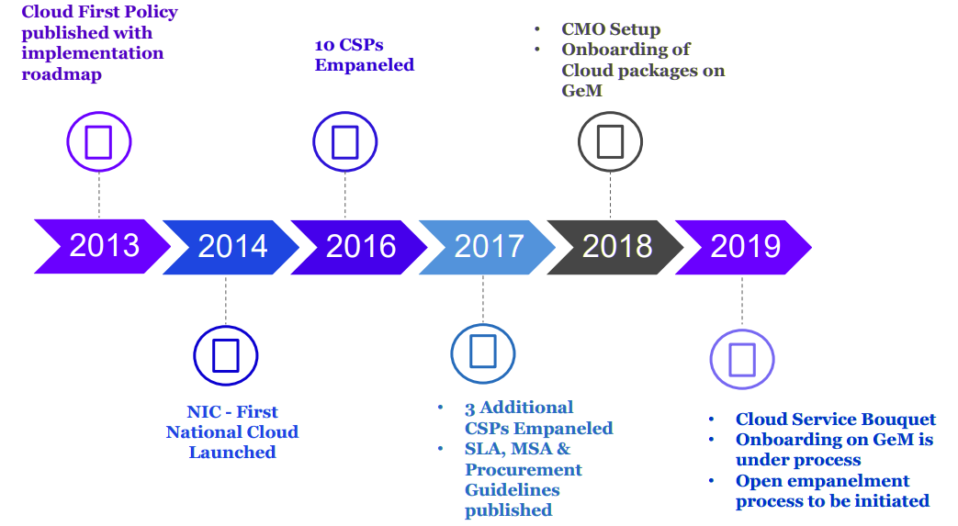
Indian Progress

Slide 33
Application on Community Cloud
Q10
e HRMS
PM Kisan Samadhan Nidhi - 6kpm
SAKHI Dashboard
MSME Portal
Central Economic Intelligence Bureau
Namami Gange
National AIDS Control Organisation
Dept of Science
Armed Forces Medical
Defence

Slide 34
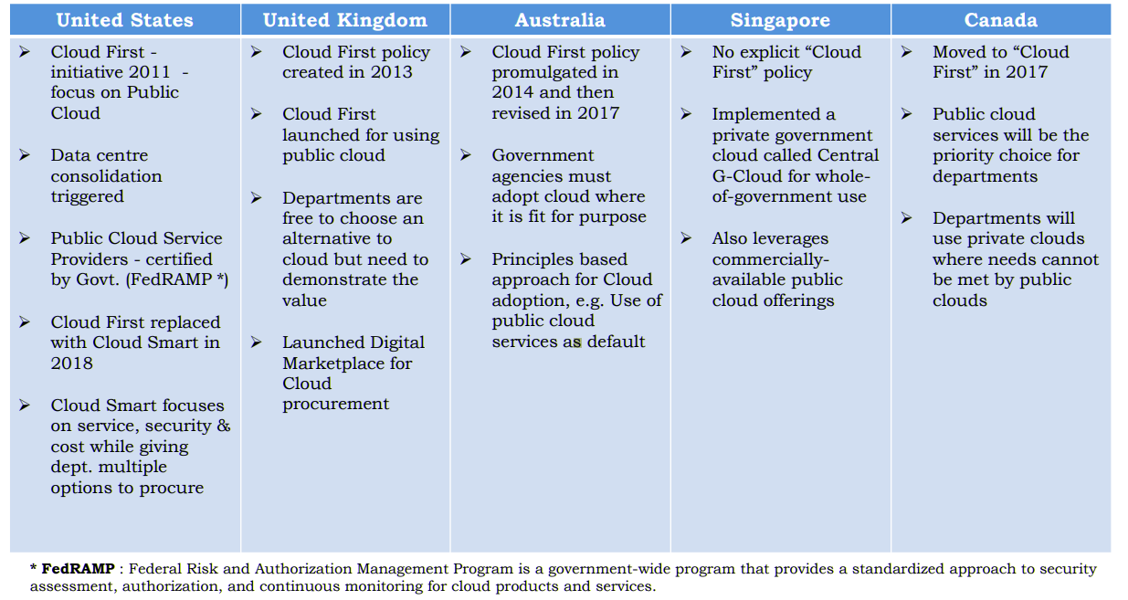
Cloud in International Public Sector

Slide 35
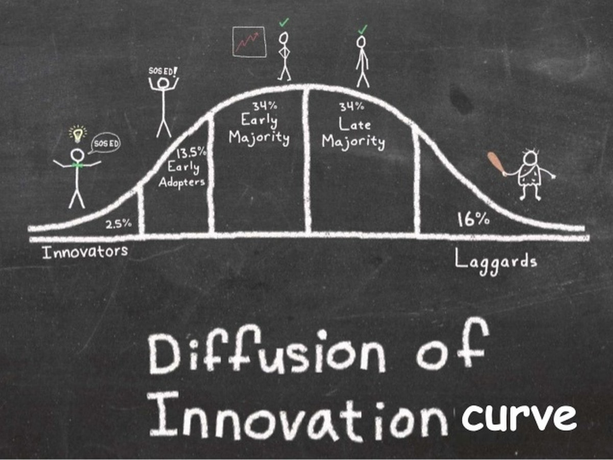
MeghRaj

Slide 36

Why (not) to Adopt Cloud?
Public Sector
Security
Compliance
Manpower
Risk
Legacy Apps
Govt Data Center
Data classification
Private Sector
Agility
Competitiveness
Speed to market
Lower cost base
Capex to Opex
New services
New products
Less Liability

Slide 37
Public Sector Barriers to Cloud
Policy
Security & Compliance
Procurement & Vendor Lock-in
Skills & Culture
Broad Adoption
computing systems developed over a long period of time in different technologies
OS not supporting
Application not supporting eg Load balancing
Hybrid requirement eg AD should work in on premises

Slide 38
Public Sector Journey to Cloud
Dev & Test
Storage Backup & DR
New Apps/Mobile
Business Process or Line of Business App
ERP, CMS
Analytics
DC Migration
Mission Critical Apps
Bring your own Encr. for Sensitive Data

Slide 39
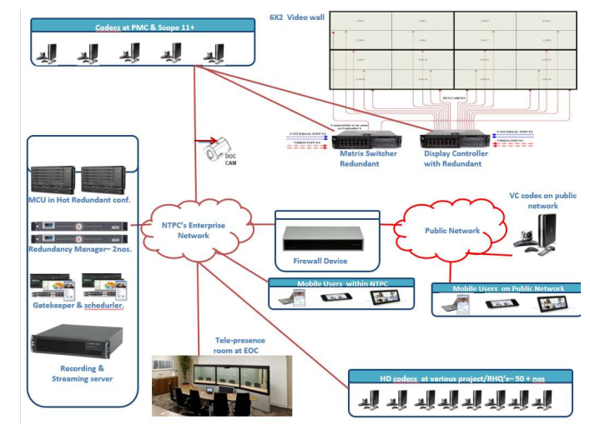
Public Sector Case Study for Journey to Cloud
NTPC has State of The Art Video Conferencing System with Telepresence connecting 60+ Location. Costing 30 Crore. Never opted cloud conferencing:
- Security
- Reluctance to Change
- Comfort
Post Corona Switched to MS Team Cloud Solution. Free of Cost.

Slide 40
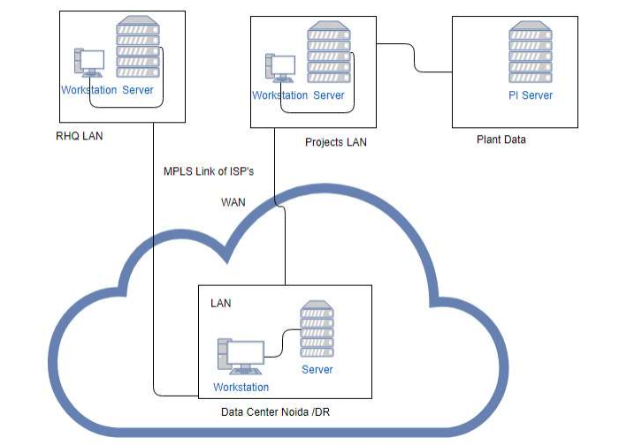
Public Sector Case Study for Journey to Cloud
NTPC has Main Data Center in Noida and Disaster Recovery Center in Hyderabad
Migration, Storage and Disaster Recovery Services (DRaaS) on Public Cloud for on premise server virtual machines (VMs) In Data Center for 5 years – Tendering Stage

Slide 41
Opportunities in Public Sector
New avenues to quickly adopt cloud infra:
New Applications on Cloud
IoT in Public Sector Enterprises
Data Analytics
ML & AI
Industrial Safety

Slide 42
Opportunities for University & Startups
Fostering entrepreneurship: By solving business problems of Government and Public sector enterprises.
Encouraging collaboration with University: To transferring knowledge from lab to practice. With provision of critical funding for talented faculty and students to pursue foundational research will help enhance the business process of Government department and Public sector.
This will also help to keep intellectual property right on the solution.

Slide 43
Job Opportunities
Cloud Architecture
Network Engineer
App Developer
Database Management
Data Analytics
Sales & Marketing

Slide 44
Thank You
Q&A
Fedback
Download PPT
http://tiny.cc/rgpv1

Slide 45
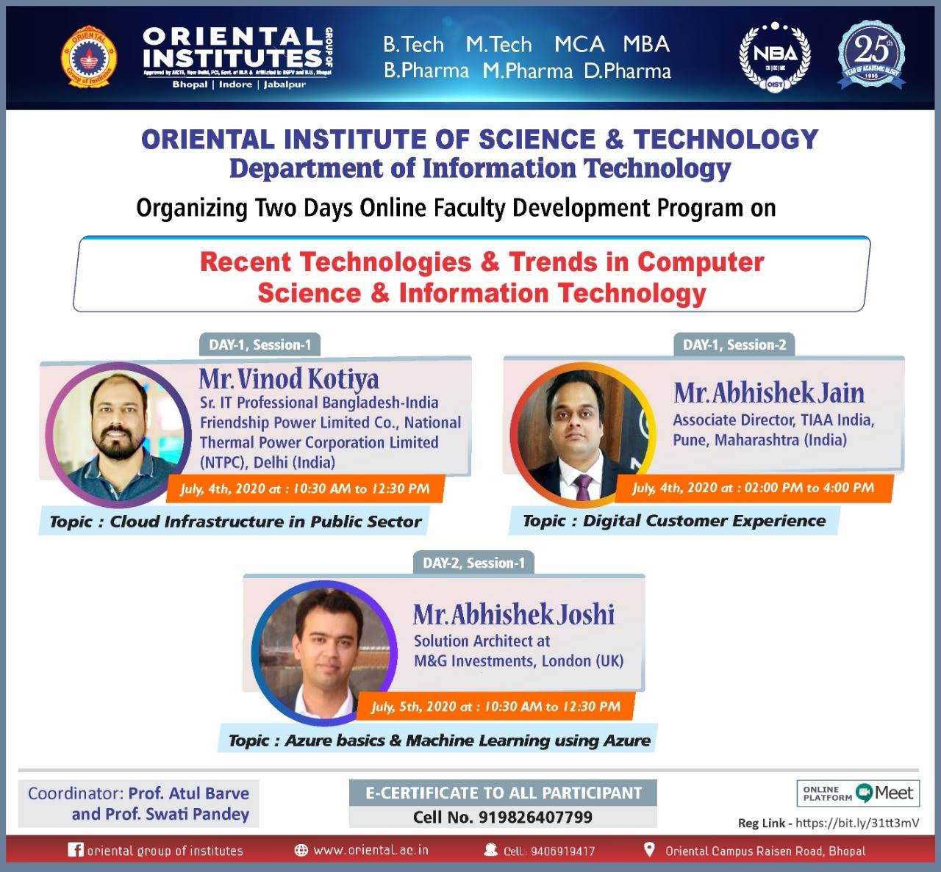

Slide 46
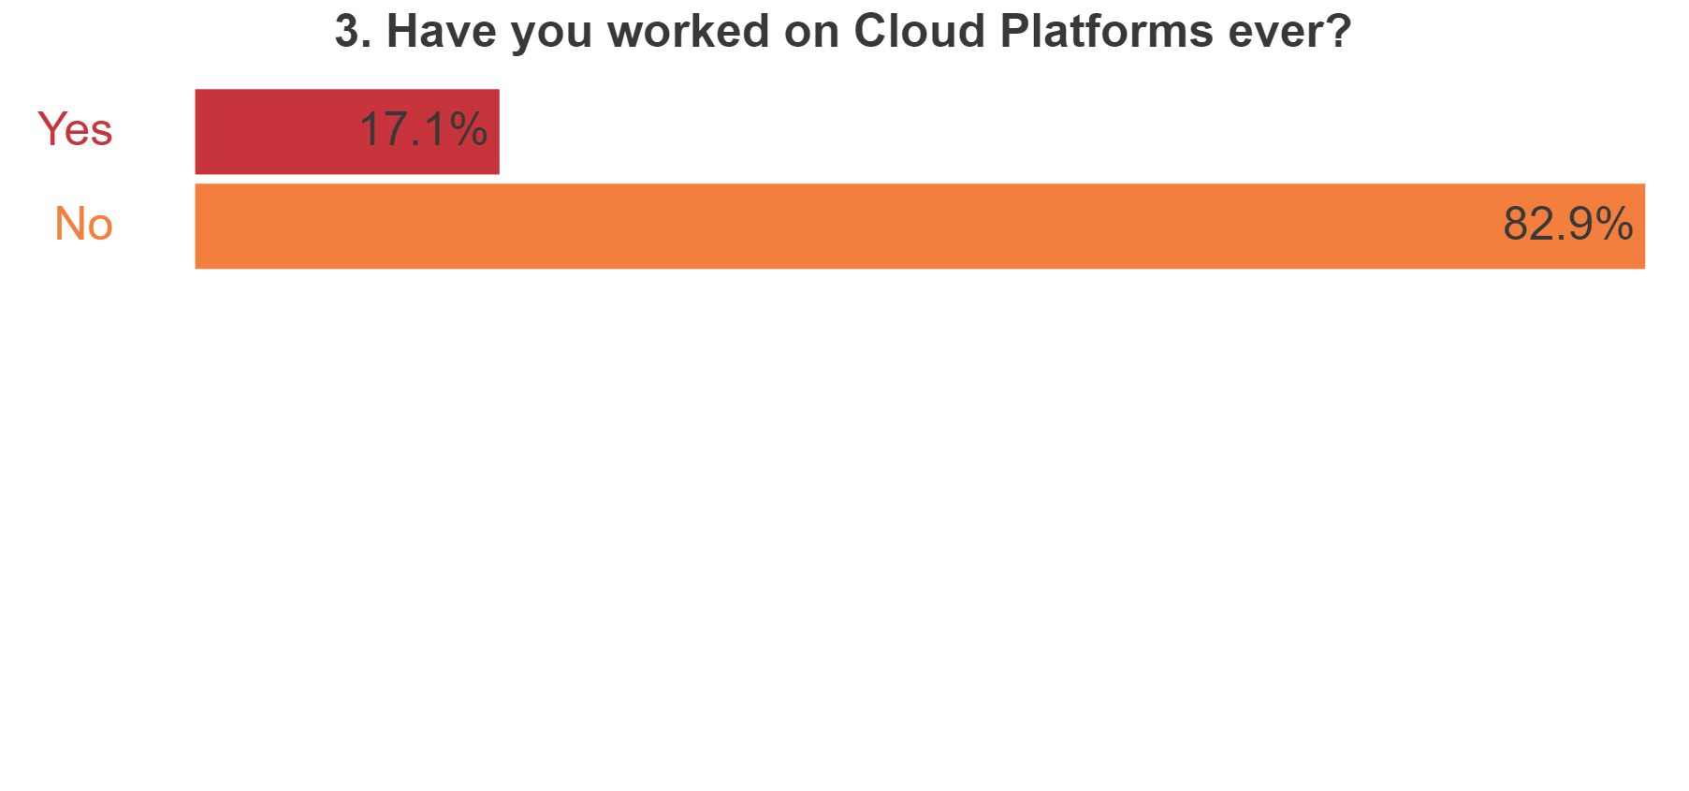

Slide 47
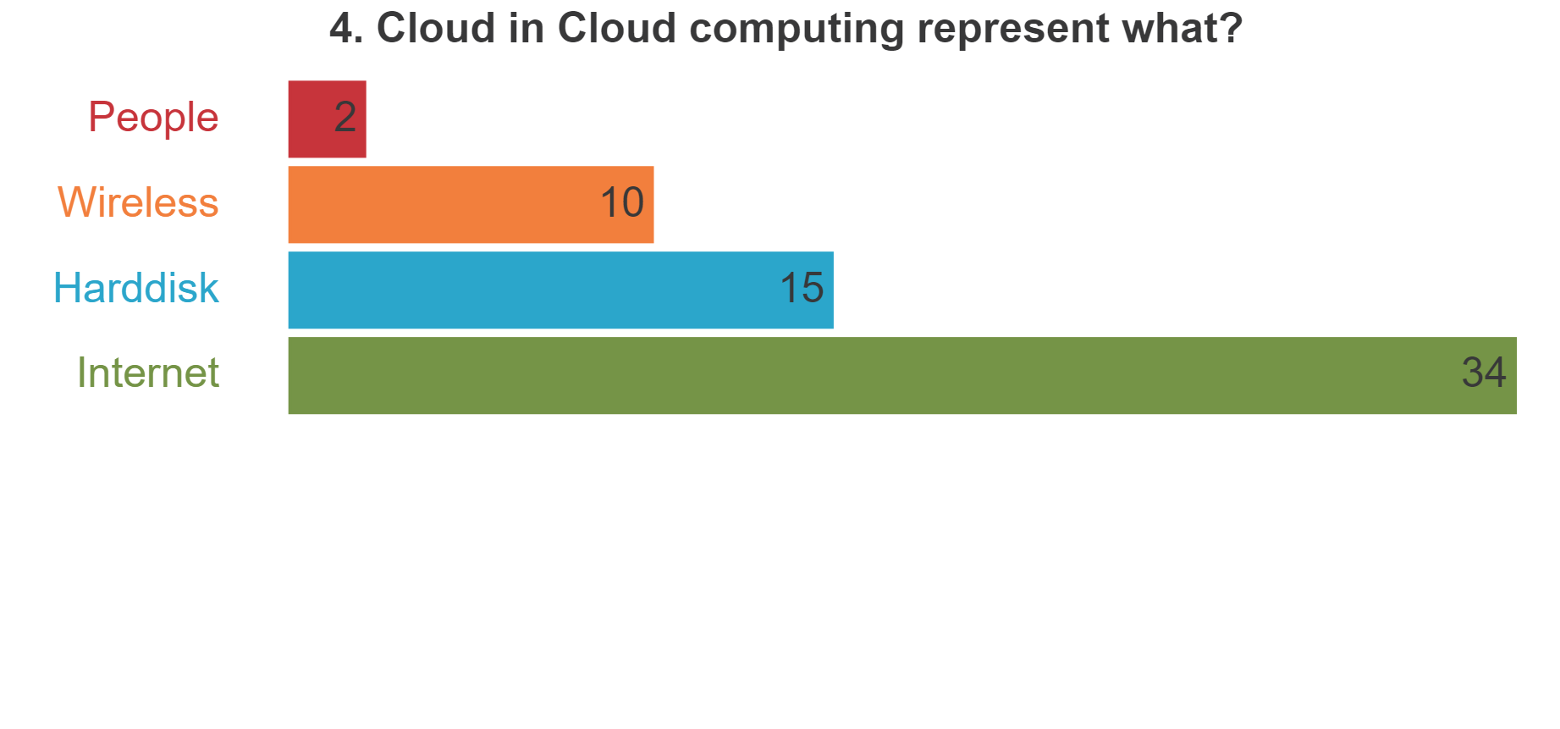

Slide 48
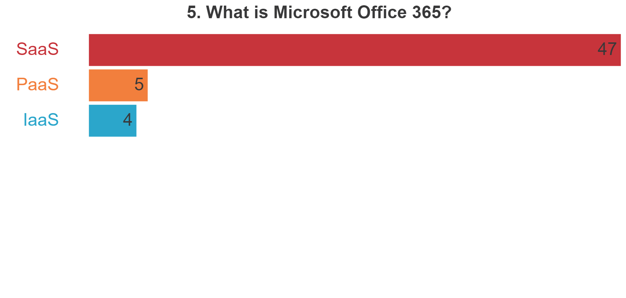

Slide 49
